Slide 1
How to Avoid Burnout and Love Teaching Again!

Slide 2
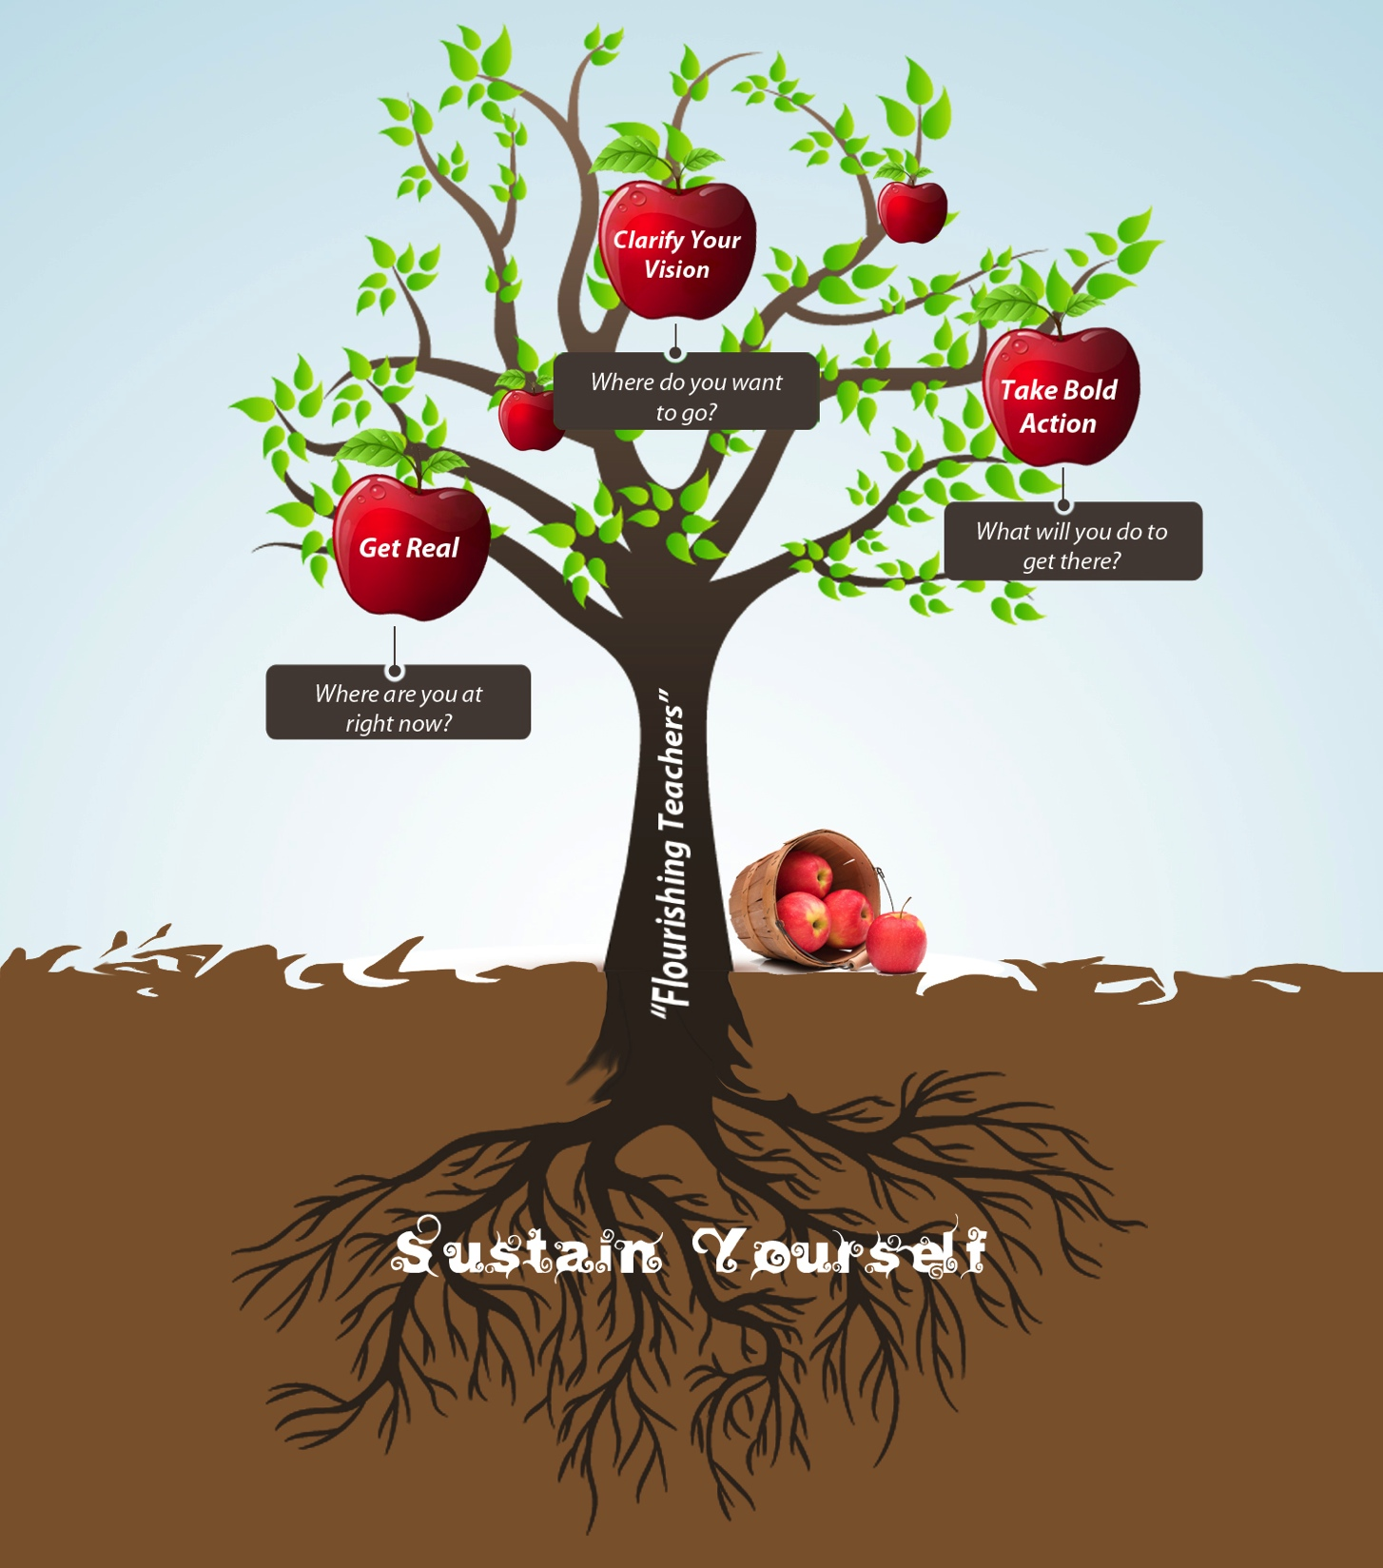

Slide 3
Agenda
Our Mission
Why are YOU here today?
Using our Strengths
The Research
What Went Well strategy
Wrap Up

Slide 4
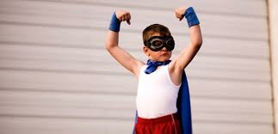
Strengths

Slide 5
Strengths

Slide 6
The Research
People who INTENTIONALLY use their strengths…
Are more likely to achieve their goals.
(Linley, Nielsen, Wood, Gillett and Biswas-Diener 2010)
Perform better at work
(Corporate Leadership Council 2002)
Experience less stress.
(Wood, Linley, Maltby, and Hurling 2010)

Slide 7
What Went Well?
Pick a moment from your teaching when you made a difference in someone’s life: a student, a colleague, a parent…
Choose a crystal clear memory

Slide 8
What Went Well?
Write about it
Get specific
What did you do or say?
How did it feel?
What went through your mind?
What happened as a result?

Slide 9
What Went Well?
Share with a partner
Listen for strengths

Slide 10
Strengths

Slide 11
What Went Well?
Share with the group
Collect our strengths

Slide 12
What Went Well?
How are you feeling about the coming school year now?
Does this shift anything for you?
Compare to what you wrote at the beginning

Slide 13
What Went Well?
What do you need from us?

Slide 14
What Went Well?
How do you want to use this in the coming school year?

Slide 15
15 ways to use What Went Well in your classroom:
Start off staff meetings
Start off TPEP conversations
When giving feedback to students
To help students self-reflect
As a PLC topic
An alternative to complaining in staff room
With colleagues after school
With spouse in the evening
At my desk at 3:15 each day
After a hard day
When I start doubting my abilities
When I wonder if I’m really making a difference
When I need to remember why I’m a teacher in the first place!
When calling a parent
When I need to find something good about a difficult person

Slide 16
What strengths do you want to commit to honoring this coming year?
Make a list
Shout out

Slide 17
What might get in your way?
Shout outs

Slide 18
How can you get the support you need to continue using What Went Well this year?
Make list
Think of 3 people to share WWW with

Slide 19
What Went Well?
What’s the single greatest thing you’re taking away from this workshop?

Slide 20
Our Gift to You
Don’t stop now!

Slide 21
Sign Up for Teach and Flourish! We’ll send out to you:
All the slides from today
A worksheet for implementing What Went Well in your teaching practice
A link to a FREE Strengths Assessment on the internet
An article I wrote about finding your Big Why and teaching from your passion
Future workshops, webinars, and opportunities to bring us into your school

Slide 22
Our BIG Gift to You

Slide 23
Thank you for working with kids! Have a fabulous year!

